Slide 1


MENTOR NAME:
TEAM MEMBERS :
MURUGASHANKAR.S
R.Sathishkumar
R.Sowmiya
A.Mekala
M.Saranya
S.Deepa

Slide 2
Data Collection and Preprocessing

Slide 3
Abstraction:
In the realm of data-driven decision-making, we embark on a journey involving data collection, context enrichment, data refinement, feature selection, and data preparation for machine learning. This process harnesses raw sales data, customer orders, and relevant sources, while intertwining it with contextual layers comprising marketing campaigns and economic indicators. The data is meticulously polished to remove impurities, ensuring its reliability. Extracting the most influential features from this refined dataset shapes the core of our predictive model. Finally, our prepared data, honed for model training, transcends into the realm of informed business forecasting.

Slide 4
Description:
In the future prediction sales data and preprocessing the following steps are used
Gather historical sales data, customer orders, and relevant sources.
Collect contextual data like marketing campaigns and economic indicators.
Clean the data, handling missing values and outliers.
Identify informative features for sales prediction.
Load and preprocess the data, enabling model training and forecasting

Slide 5
Gather Historical Sales Data:
1.Gather transaction records: Collect data on past transactions, including the date, customer ID, product purchased, quantity, and sales amount.
2. Customer orders: Gather information about customer orders, such as order date, order ID, and customer details.
3. Relevant data sources: Incorporate any other relevant data sources, such as store location, product categories, and seasonal information.

Slide 6
Collect Contextual Data:
2.1. Marketing campaigns: Collect data on marketing campaigns, including their start and end dates, budget, and channels used.
2.2. Promotions: Include information about any sales promotions, discounts, or special offers during specific time periods.
2.3. Economic indicators: Gather economic data like inflation rates, GDP growth, and interest rates, which can affect sales.
2.4. Industry trends: Research and collect information about trends and developments in your industry.

Slide 7
Clean and Preprocess the Data:
Data Cleaning:
Handle missing values: Fill in or remove missing data.
Remove duplicates: Eliminate any duplicate records.
Handle outliers: Identify and address outliers that may skew the analysis
Data Consistency:
Ensure consistent data formats and units.
Standardize date formats if necessary.

Slide 8
Apply Feature Selection:
Identify Relevant Features:
Perform exploratory data analysis (EDA) to understand the relationships between variables.
Feature Engineering:
Create new features that may provide additional insights.
Feature Scaling and Encoding:
Scale numeric features if necessary (e.g., using StandardScaler).
Use domain knowledge to select features relevant to sales prediction.
For example, you could create features like "day of the week," "month," or "season" from date fields.
Encode categorical features (e.g., one-hot encoding for marketing channels).

Slide 9

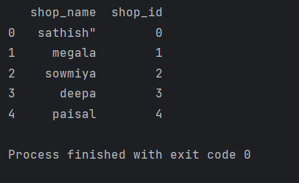
Load and preprocessing the Dataset:
Code:
Output:

Slide 10
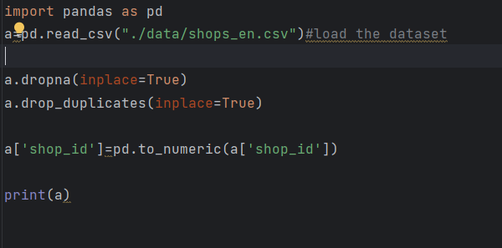
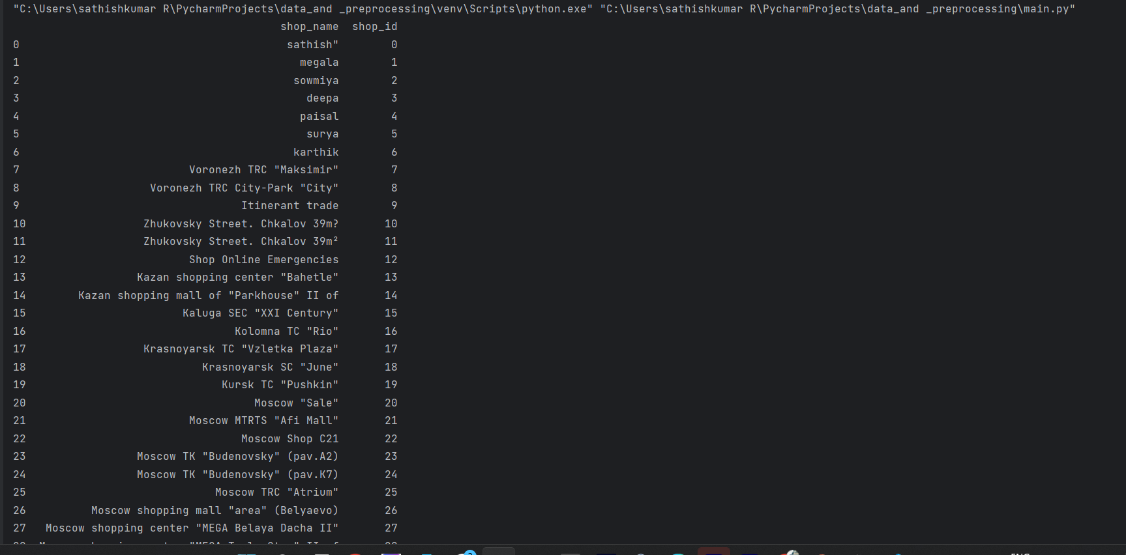
Output:

Slide 11
Thank you

